Slide 1

FACE RECOGNITION BASED ATTENDANCE SYSTEM
Submitted to:
Ms. Rashika Singh
Submitted By:
Priyanshu Ku. Choubey [21CSE(AIML)24]
Priya Jha [L22CSE(AIML)03]
Pooja Chauhan [L22CSE(AIML)02]

Slide 2
INTRODUCTION
Face recognition technology has the potential to revolutionize the way attendance is tracked. Face recognition-based attendance systems can automatically identify individuals and mark their attendance, eliminating the need for manual attendance taking. In colleges, universities, organizations, schools, and offices, attendance is one of the most important tasks that must be done on a daily basis. The majority of the time, it is done manually, such as by calling by name or by roll number. The main goal of this project is to create a Face Recognition based attendance system that will turn this manual process into an automated one. This project meets the requirements for bringing modernization to the way attendance is handled, as well as the criteria for time management.

Slide 3
OBJECTIVES OF PROJECT
The objective of this project is to develop a face recognition based attendance system. This project has the following specific objectives:
● Develop a face recognition-based attendance system that is accurate, affordable, and easy to use.
● Reduced time and cost associated with attendance tracking.
● Improved accuracy of attendance records.
● To record the attendance of the identified student.

Slide 4





TECHNOLOGIES USED

Slide 5
ABOUT THE TECHNOLOGIES
Python is a widely used programming language for machine learning and computer vision projects. It offers a rich ecosystem of libraries and frameworks that are essential for tasks such as data preprocessing, model training, and real-time processing.
OpenCV (Open Source Computer Vision Library) is a powerful open-source computer vision library that provides a wide range of functions for image and video processing.
.
Visual C++ is an integrated development environment (IDE) from Microsoft that is powerful compiler and linker that can generate optimized code for a variety of platforms.
Jupyter Notebooks provide an interactive environment for developing and documenting code. They're particularly useful for experimenting with code snippets, visualizing data, and sharing insights.

Slide 6
HARDWARE REQUIREMENTS
Processor : Intel Pentium IV or above
Memory (RAM) : 4 GB or more
Hard Disk : 512 GB or more
USB : Flash usb port

Slide 7
SOFTWARE REQUIREMENTS
Browser : Chrome or Internet Explorer
Operating System : Windows 7 or higher
IDE : Visual C++
Language: Python

Slide 8
APPLICATIONS OF PROJECT
Educational institutions: Schools, universities, and colleges can use face recognition-based attendance systems to automate attendance tracking and reduce the administrative burden on teachers and staff.
Employee attendance: Businesses can use face recognition-based attendance systems to accurately track employee attendance and eliminate the need for manual sign-in sheets or RFID cards. This can reduce payroll fraud and ensure that employees are paid for the hours they work.
Access control: Face recognition-based attendance systems can be integrated with access control systems to control access to restricted areas, such as buildings, laboratories, and secure facilities. This can help to improve security and prevent unauthorized access.

Slide 9

SCOPE OF PROJECT
The scope of the proposed project is the development of an attendance tracking system that can use the face recognition model and face detection module to automatically identify individuals and mark their attendance. The attendance tracking system will be implemented in Python and will be easy to use and maintain.

Slide 10
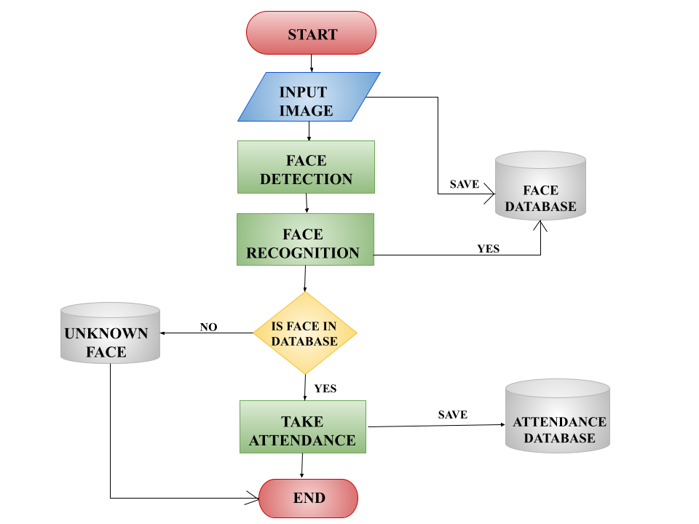
DATA FLOW DIAGRAM

Slide 11

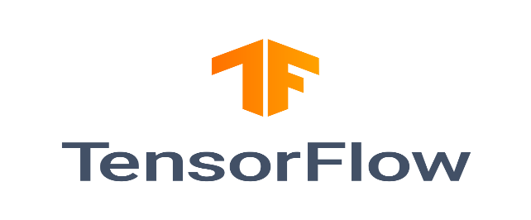

PROJECT MODULES
(MODULES DESCRIPTION)
A convolutional neural network (CNN) is a type of artificial neural network that is well- suited for image processing and recognition tasks.
TensorFlow is a popular open-source machine learning library can be used to build and train a variety of machine learning models, including face recognition models.
Dlib is a C++ library for machine learning applications. It provides a wide range of tools for computer vision, including face detection, face landmark detection, and object detection.

Slide 12
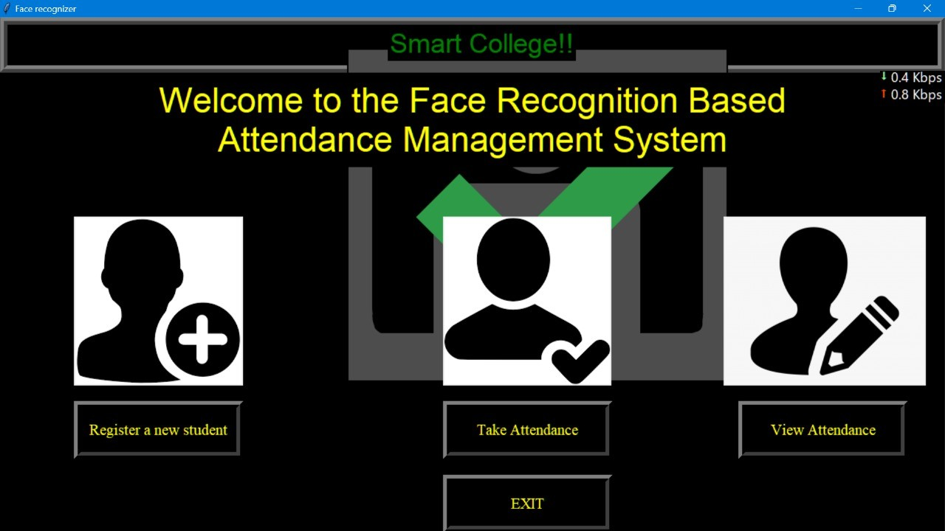
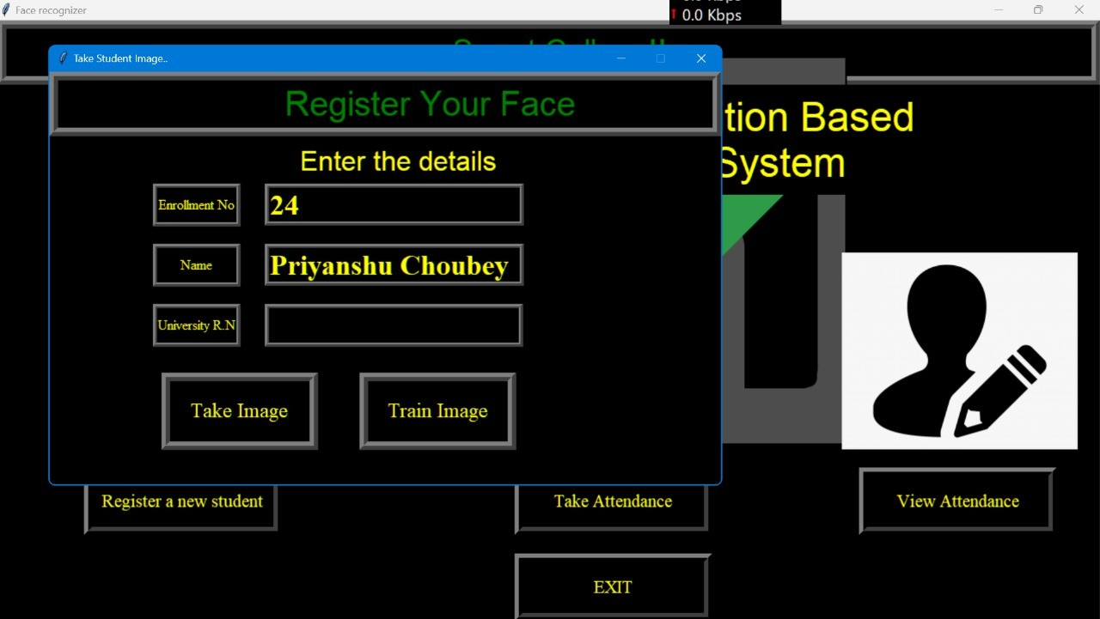
SCREENSHOTS

Slide 13
CONCLUSION
Face recognition systems are now developing faster and faster, more and more used in people's lives. Face recognition systems are part of facial image processing applications and their significance as a research area are increasing recently. Implementations of system are crime prevention, video surveillance, person verification, and similar security activities. The face recognition system implementation can be part of Universities. Face Recognition Based Attendance System has been envisioned for the purpose of reducing the errors that occur in the traditional (manual) attendance taking system. The aim is to automate and make a system that is useful to the organization such as an institute. The efficient and accurate method of attendance in the office environment that can replace the old manual methods. This method is secure enough, reliable and available for use.

Slide 14
REFERENCES
https://nevonprojects.com/auto-attendance-system/
https://www.analyticsvidhya.com/blog/2021/11/build-face-recognition-attendance-system-using-python/
https://digitalcommons.montclair.edu/cgi/viewcontent.cgi?article=1729&context=etd
https://commons.und.edu/cgi/viewcontent.cgi?article=5363&context=theses
https://www.iitms.co.in/blog/automated-student-attendance-management-system-for-schools-and-colleges.html

Slide 15
THANK YOU !

